Slide 1


9 Quantum’s Morris
Team: “We’ll Figure it Out!”

Slide 2

Overview
Goals
What we Accomplished
The Methods
Results
Benefits and What’s next?
1

Slide 3
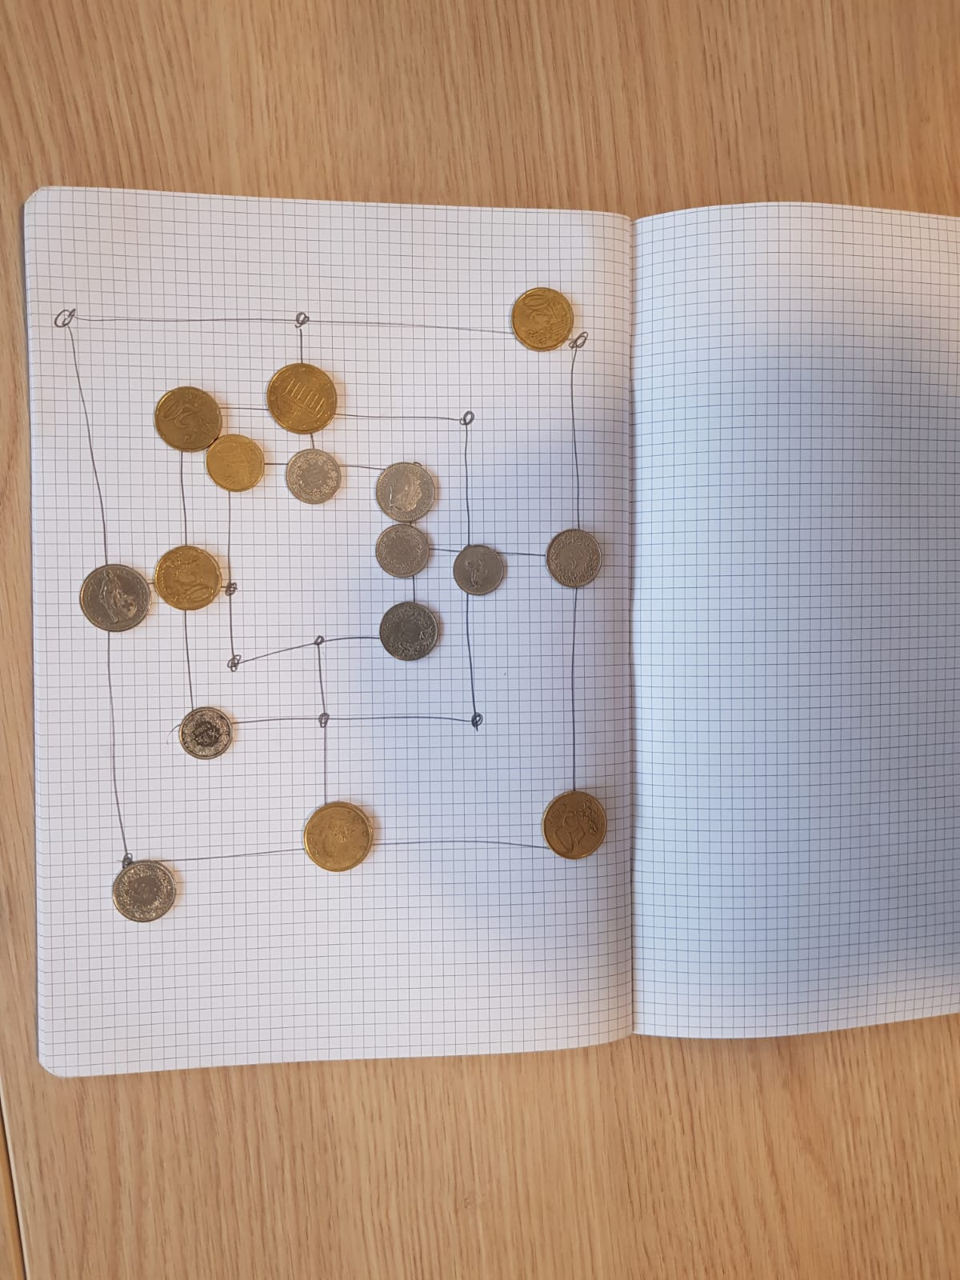
GOALS
Learning Nine Men’s Morris
Applying quantum computing methods to solve game problems.
Building a quantum agent.
2

Slide 4
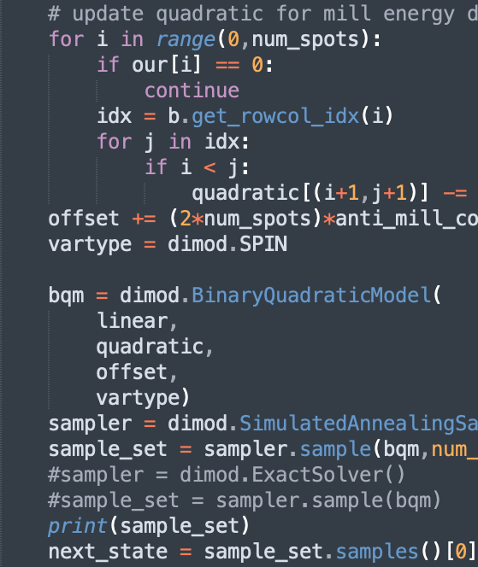
What we Accomplished
Built a classical version of Three Men’s Morris.
Built a GUI
Created an agent based on quantum computing.
1
3

Slide 5
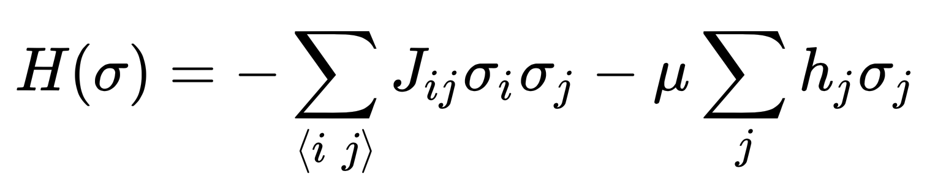
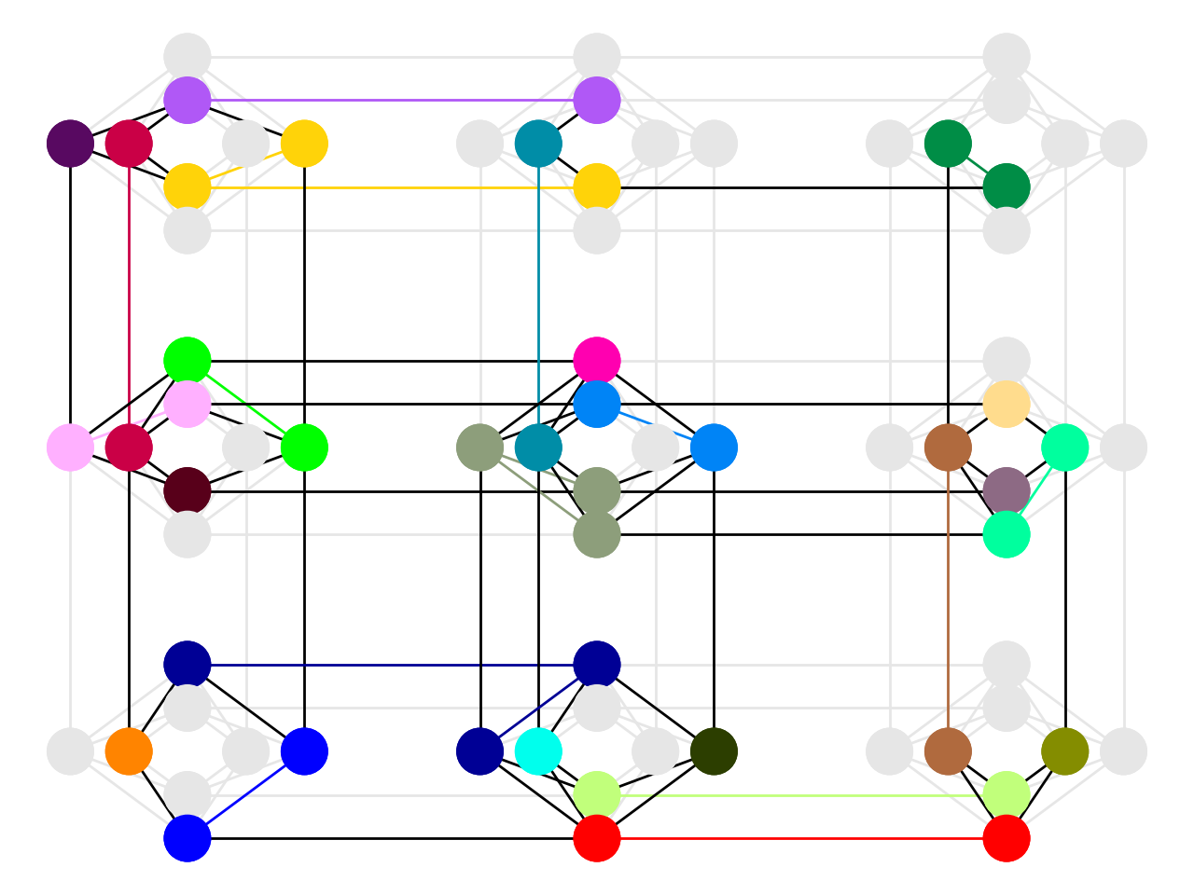
The Method
4

Slide 6
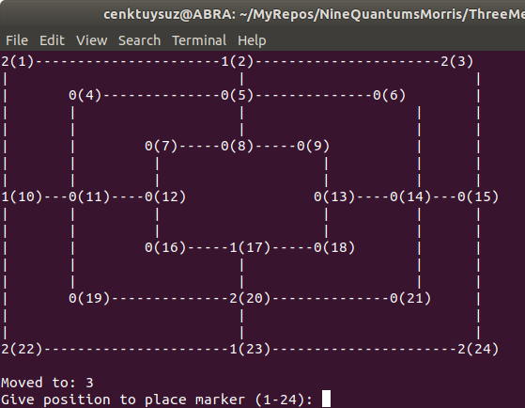
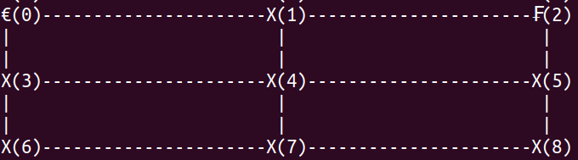
Initial Results
3 men’s morris
9 men’s morris
5

Slide 7
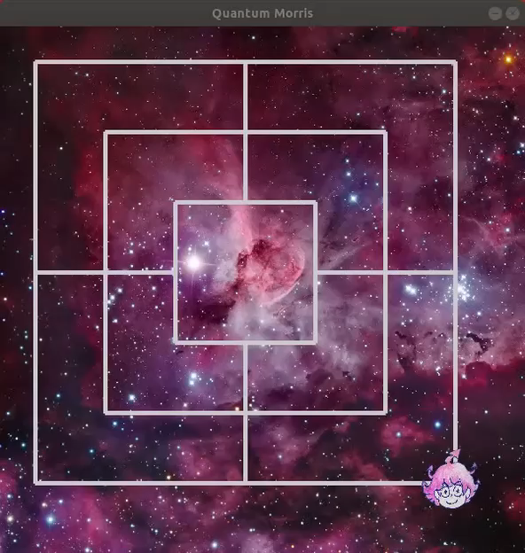
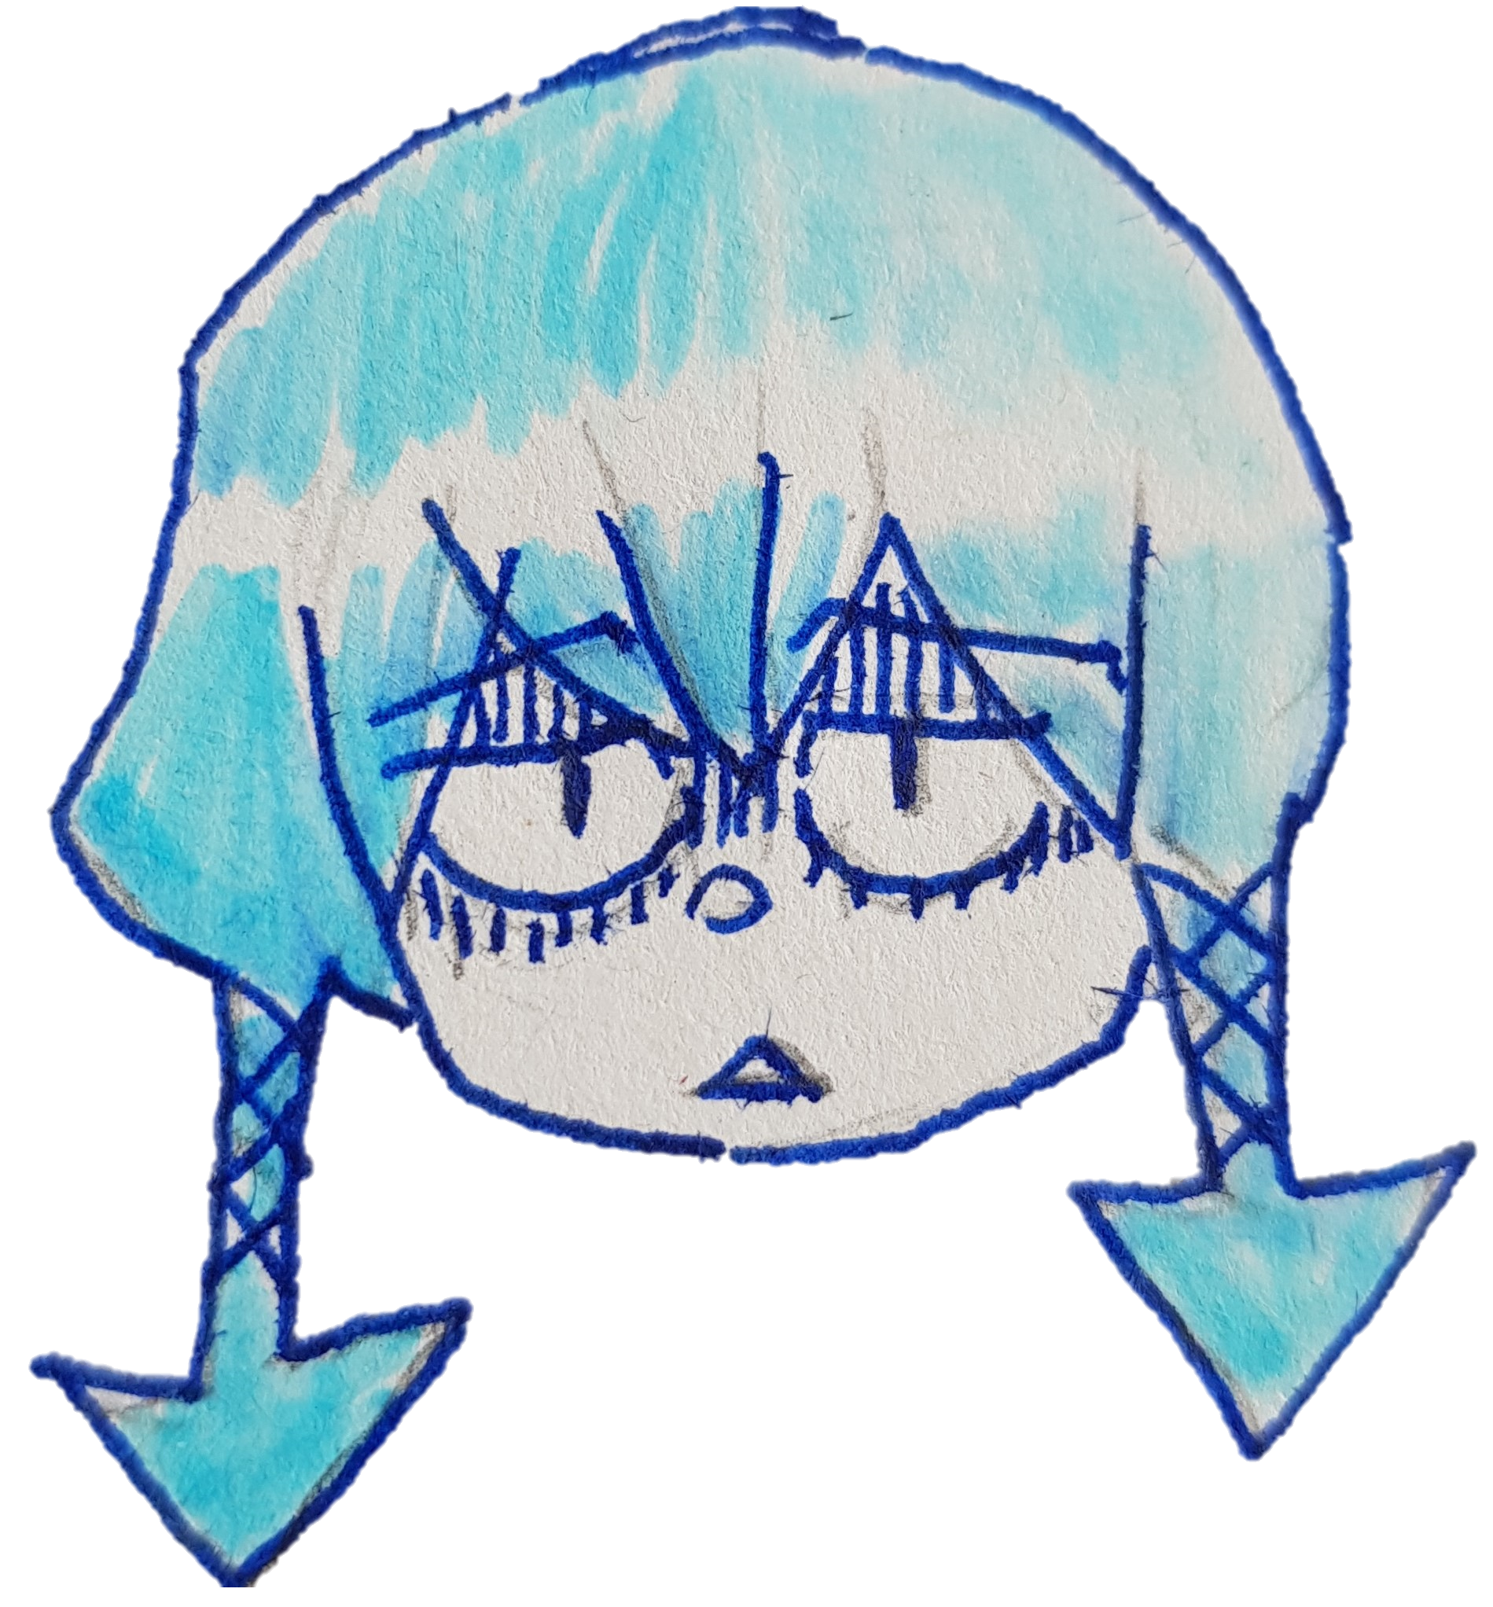
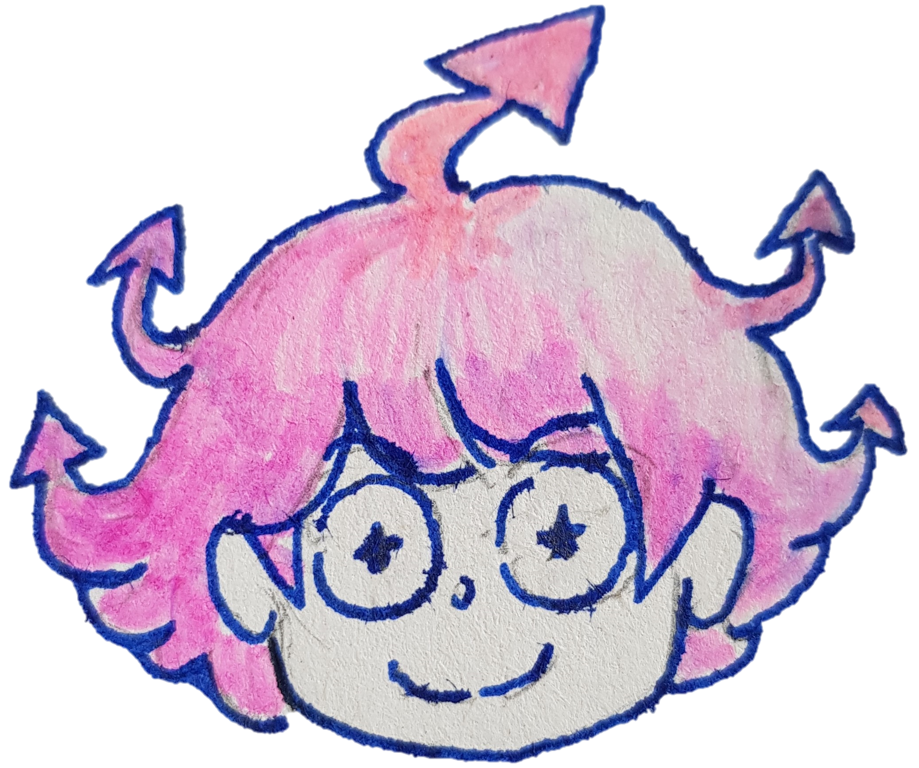
Final Result
Down
Up
6

Slide 8
Benefits and What’s Next?
Improved understanding of the Ising Model and of its applicability.
Developed a simple game that could raise interest in Quantum Machines
Next? Tuning the coupling constants of the Hamiltonian with Machin Learning techniques.
7

Slide 9
Thank you!
You are welcome to come and play!
:D

